Slide 1


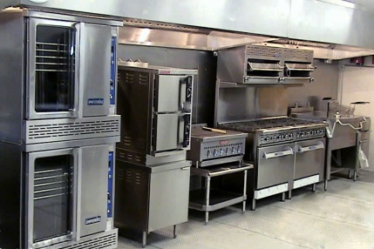
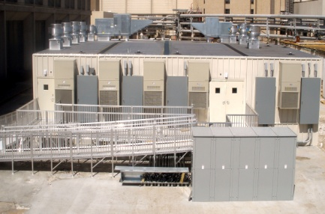
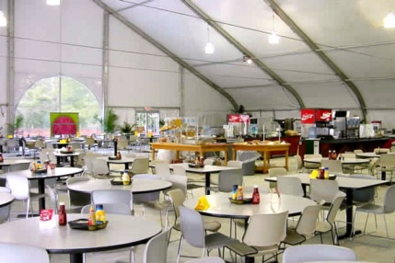
“The Missing Piece To Your Temporary Needs!”
www.kitchencorps.com

Slide 2
WHO IS KITCHEN CORPS, INC.?
MISSION STATEMENT
Provide a functional and collateral temporary facilities which meets federal sanitation and food service requirements and exceeds customer expectations.
Establish a relationship with potential customers; identify ; evaluated space availability for a temporary kitchen facility; identify final floor plan; develop a and provide recommendations which meet customer specific requirements and space availability.
Identify delivery date, and estimated time of set up at site location.
CORPORATE VALUES
to our team members and to their development, participation, and recognition.
Products and services we deliver are always of the
to serving our customers and exceeding their expectations.
Constantly explore and methods in order to increase our effectiveness.
Aggressively seek effective partnership to improve our and quality.
Act ; be open, honest and fair, be true to our word, and take full for our actions.
commercial
Committed
temporary kitchen facility
highest quality
Devoted
professional
customer requirements
new ideas
logical plan
service
ethically
realistic
responsibility

Slide 3
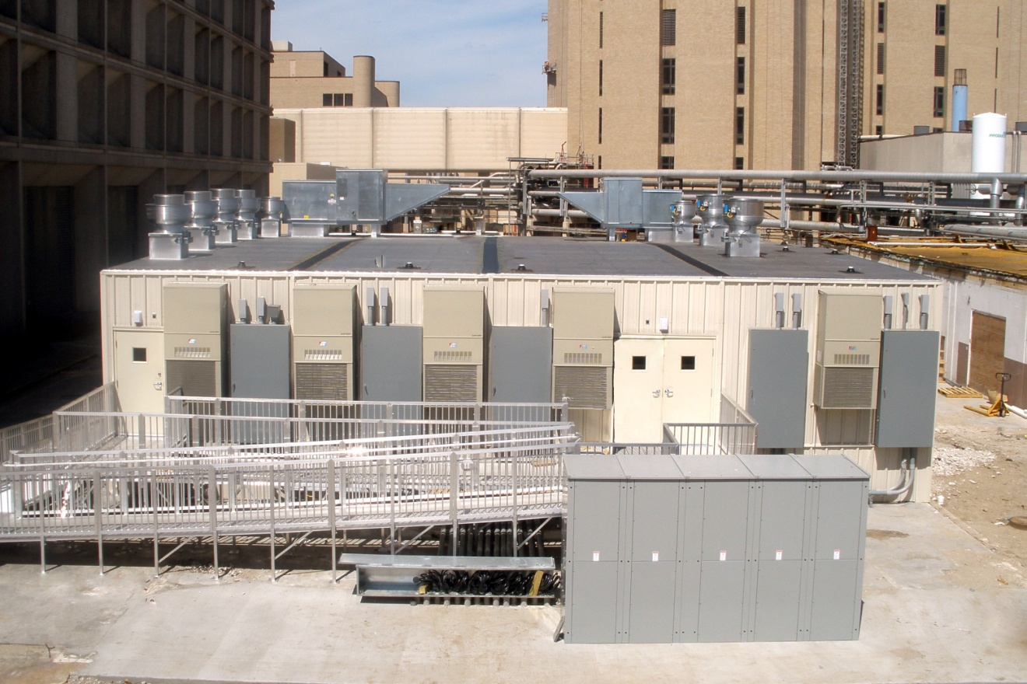
WHAT DOES KITCHEN CORPS, INC. OFFER?
TEMPORARY KITCHEN FACILITIES
OPEN FLOOR PLANS
ACCESSIBILITY TO ALL AREAS
SOLID CONSTRUCTED STRUCTURES
CUSTOMIZABLE
TEMPERATURE CONTROLLED

Slide 4
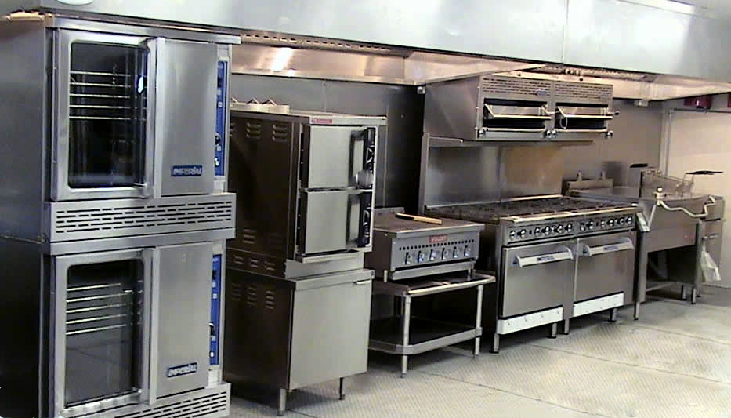
WHAT DOES KITCHEN CORPS, INC. OFFER?
PRODUCTION AREAS
UL LISTED HOOD
COMMERCIAL EQUIPMENT
TOTAL FLOW FIRE SUPPRESION
TEMPERED MAKE UP AIR
ALL FOOD GRADE MATERIAL

Slide 5
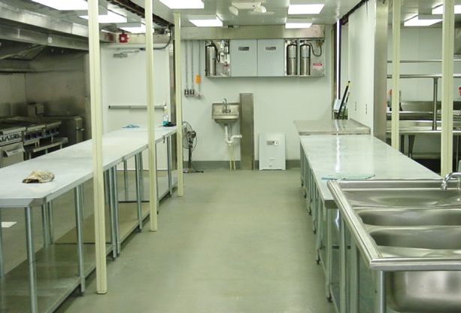
WHAT DOES KITCHEN CORPS, INC. OFFER?
PREPARATION AREAS
PREPARATION TABLES/SINKS
TABLE SHELVING
MULTIPLE RECEPTACLES
REFRIGERATION
ALL FOOD GRADE MATERIAL

Slide 6
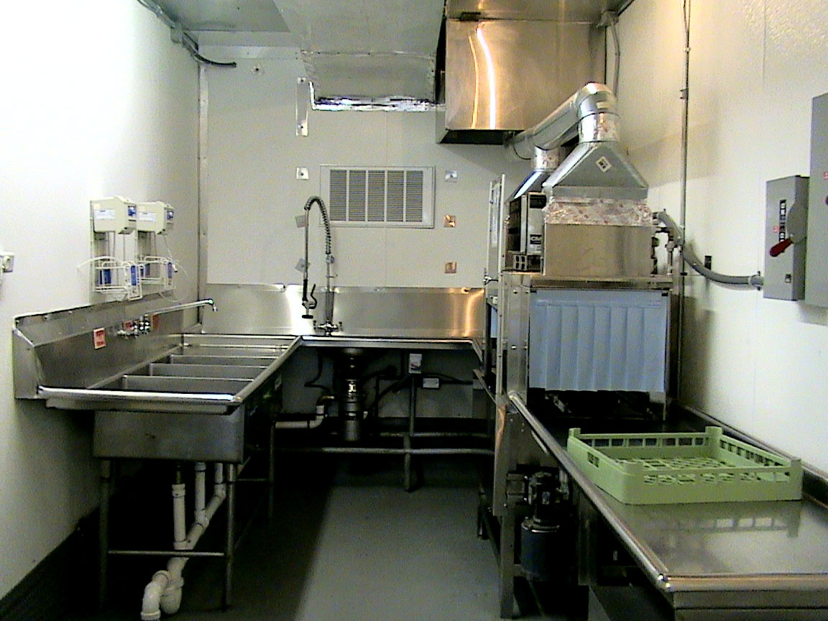
WHAT DOES KITCHEN CORPS, INC. OFFER?
DISHWASHING AREAS
COMMERCIAL DISHMACHINE
CLEAN/DIRTY TABLES
3 COMPARTMENT SINK
GARBAGE DISPOSAL
VENTILATION
ALL FOOD GRADE MATERIAL

Slide 7
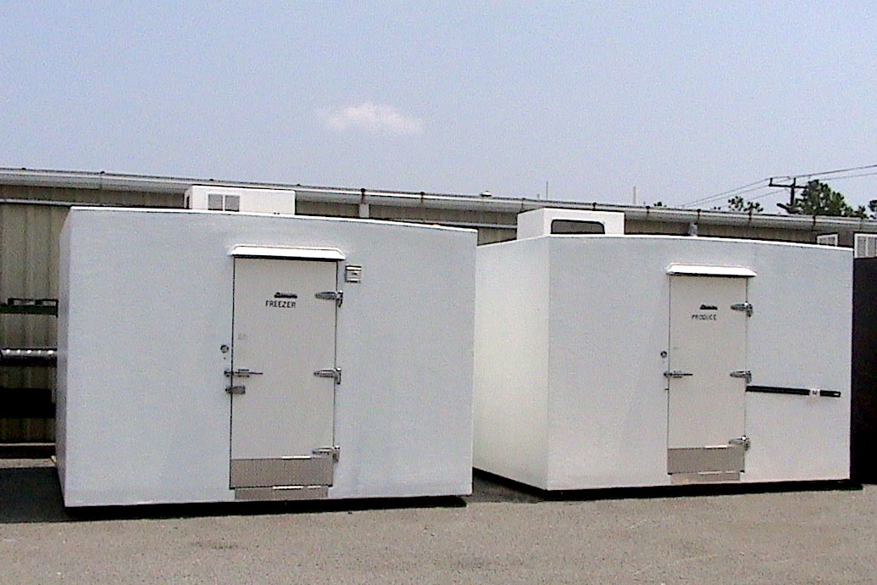
WHAT DOES KITCHEN CORPS, INC OFFER?
REFRIGERATION/FREEZER
DUAL TEMP REFRIGERATION SYSTEMS
ACCESSIBILITY FROM TEMPORARY FACILITY
OPTIONAL STAND-ALONE
MULTIPLE SIZES

Slide 8
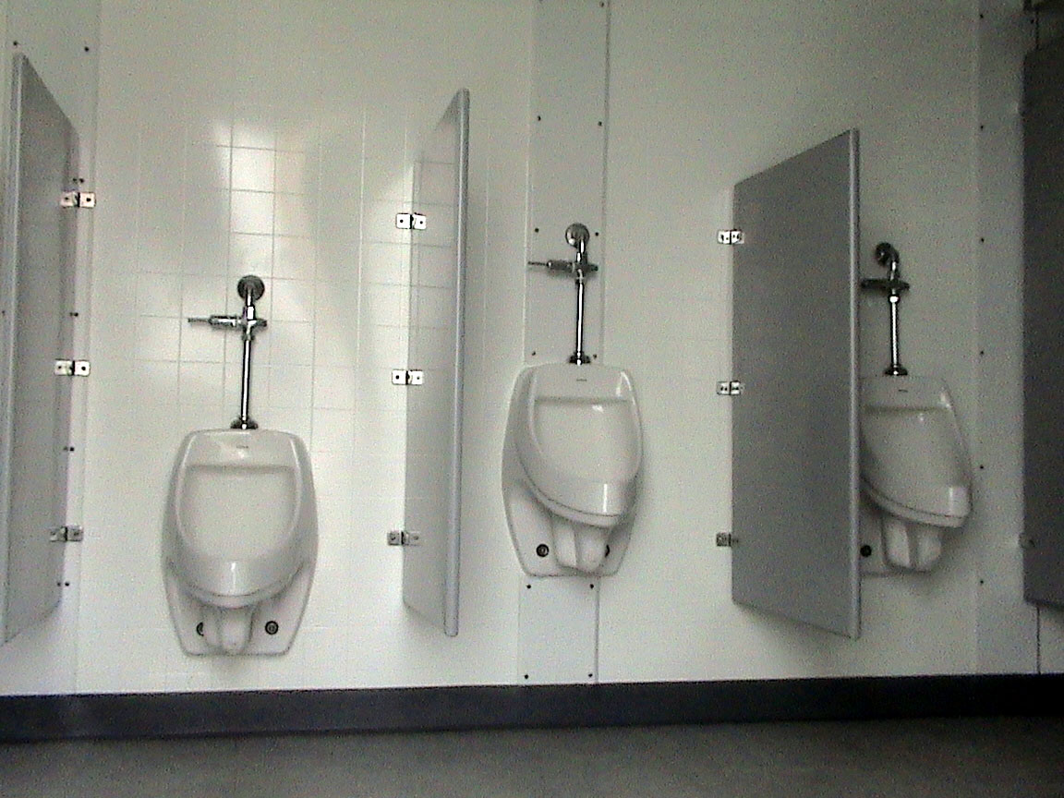
WHAT DOES KITCHEN CORPS, INC. OFFER?
BATHROOM FACILITIES
GENDER SPECIFIC AREAS
TOILETS & URINALS
HAND SINKS
ADA COMPLIANT
VENTILATION

Slide 9
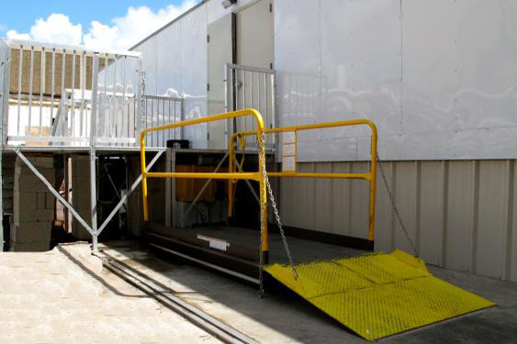
WHAT DOES KITCHEN CORPS, INC. OFFER?
ADDITIONAL OPTIONS
DECKING, RAMPS, AND LIFTS
GENERATED POWER
OFFICES
BUNK HOUSES
SHOWERS
SERVICE OR PREVENTATIVE MAINTENANCE AGREEMENTS

Slide 10
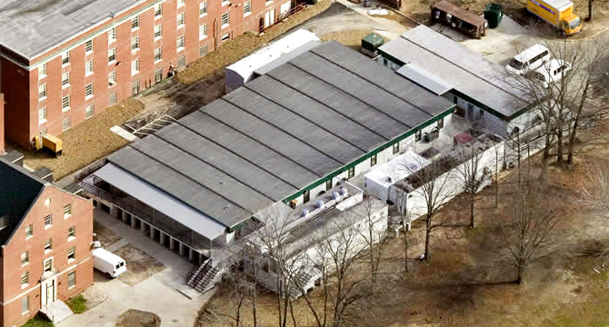

WHEN & WHERE IS KITCHEN CORPS, INC. NEEDED?
EDUCATIONAL INSTITUTIONS

Slide 11
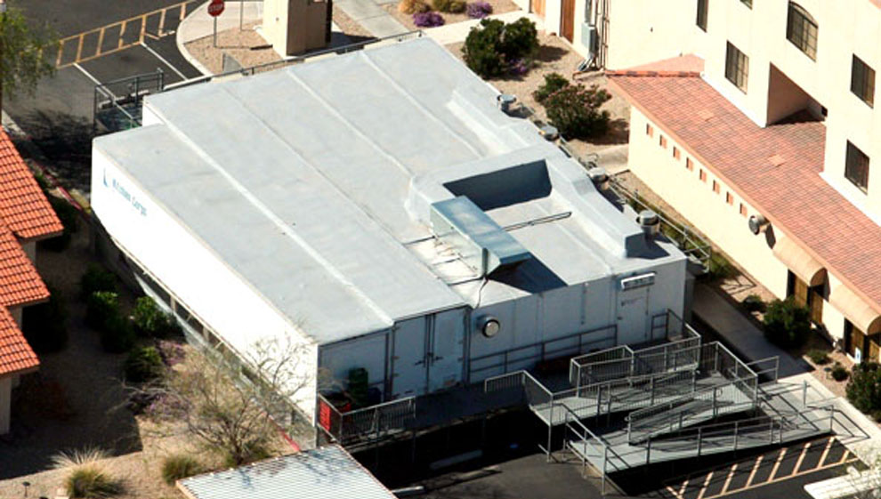

WHEN & WHERE IS KITCHEN CORPS, INC. NEEDED?
HEALTHCARE INSTITUTIONS

Slide 12
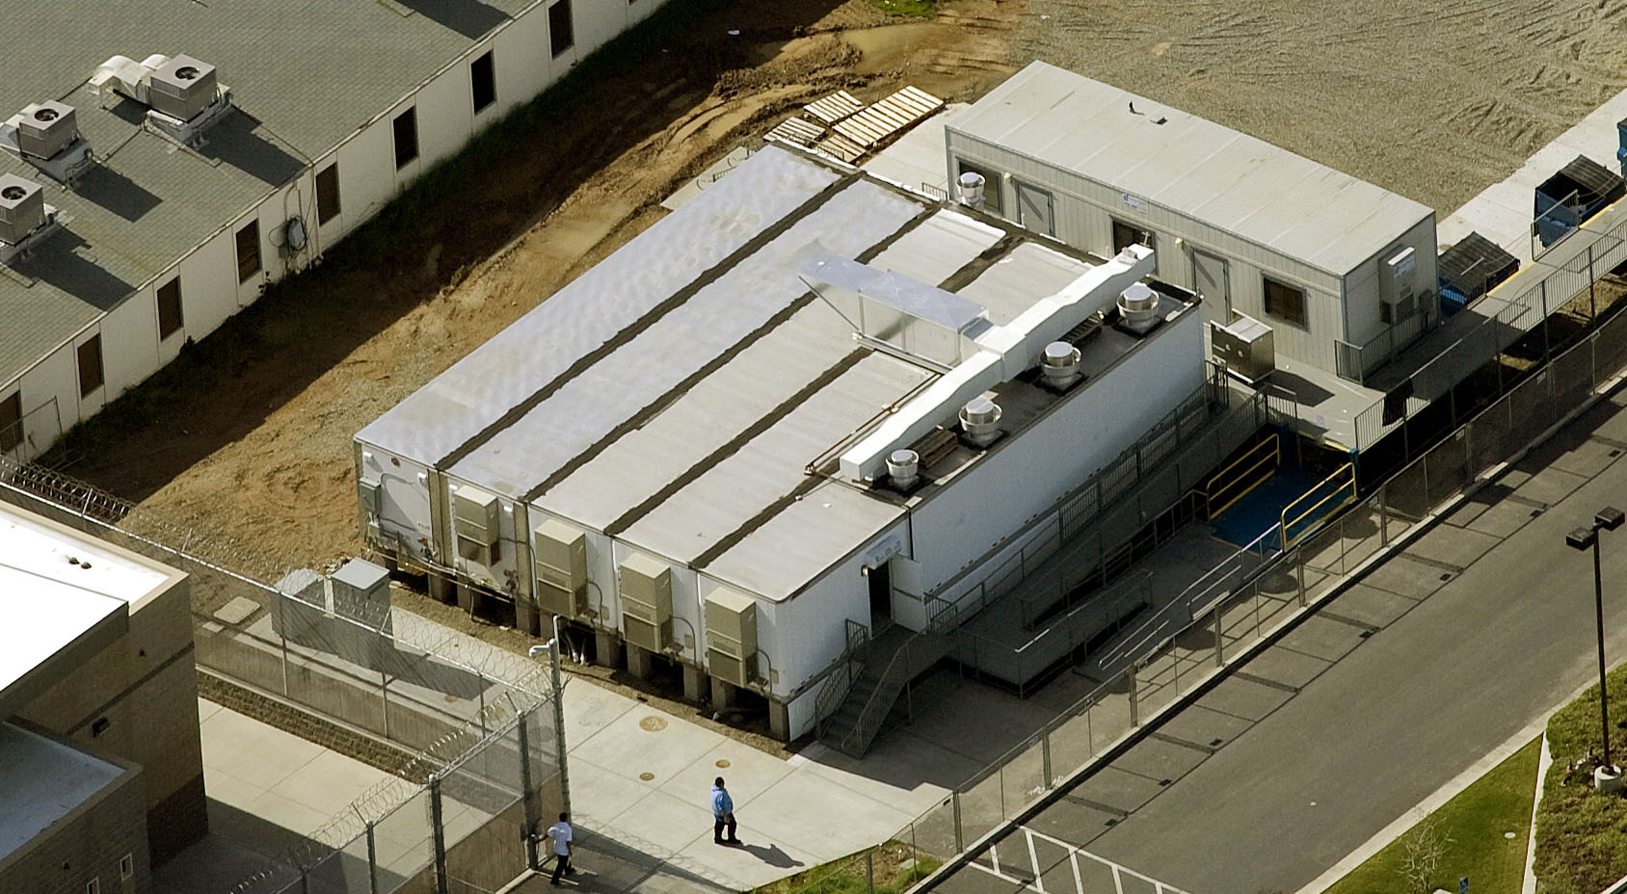

WHEN & WHERE IS KITCHEN CORPS, INC. NEEDED?
CORRECTIONAL INSTITUTIONS

Slide 13
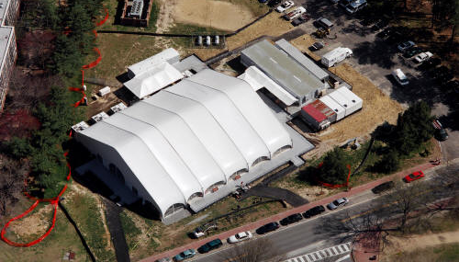

WHEN & WHERE IS KITCHEN CORPS, INC. NEEDED?
HOSPITALITY INSTITUTIONS

Slide 14
WHEN & WHERE IS KITCHEN CORPS, INC. NEEDED?
FACILITY RENOVATION
FACILITY EXPANSION
DISASTER RELIEF
REMOTE OPERATIONS
NEW PERMANENT FACILITY
Your project
It is important to keep your food service facility updated and capable of handling not only your current situation but also any unforeseen changes your facility may undergo. Whatever your situation is, Kitchen Corps, Inc. will be there to assist in the continuation of service to your clients by providing a state-of-the-art temporary kitchen facility.

Slide 15
HOW IS KITCHEN CORPS, INC GOING TO HELP YOU?
FACILITY & EQUIPMENT
The best solution for your temporary food service needs.
Flexible commercial cooking production lines
Facilities made with work flow and production in mind
SERVICE
Professionalism
Effectiveness
Innovation
Knowledge
Resourcefulness
Pride in work
Consistency
Responsiveness

Slide 16

KITCHEN CORPS, INC.
THANKS YOU FOR VIEWING
WE LOOK FORWARD TO DISCUSSING
YOUR TEMPORARY FACILITY PROJECT
FOR MUCH MORE PRODUCT INFORMATION PLEASE VISIT US AT OUR WEBSITE…
WWW.KITCHENCORPS.COM

